Slide 1
Smart Library management System using pega By
N.Noble Sujani Y22AIT486
M.Aswitha Y22AIT477
M.Rajeswari Y22AIT479
K.Harsha L23AIT538
E.Jashuva L23AIT534
Under the Esteemed Guidance
of
Sk Shareen
Assistant Professor

Slide 2
Domain knowledge
Low-code platform
Focuses on logic and functionality instead of complex coding
Faster development (up to 10x faster)
All-in-one platform (frontend, backend, database, cloud in one system)
Rule-based system (everything in Pega is a rule)
Automatic code generation in the background
Supports workflow automation
Used for BPM (Business Process Management)
Used for CRM (Customer Relationship Management)

Slide 3
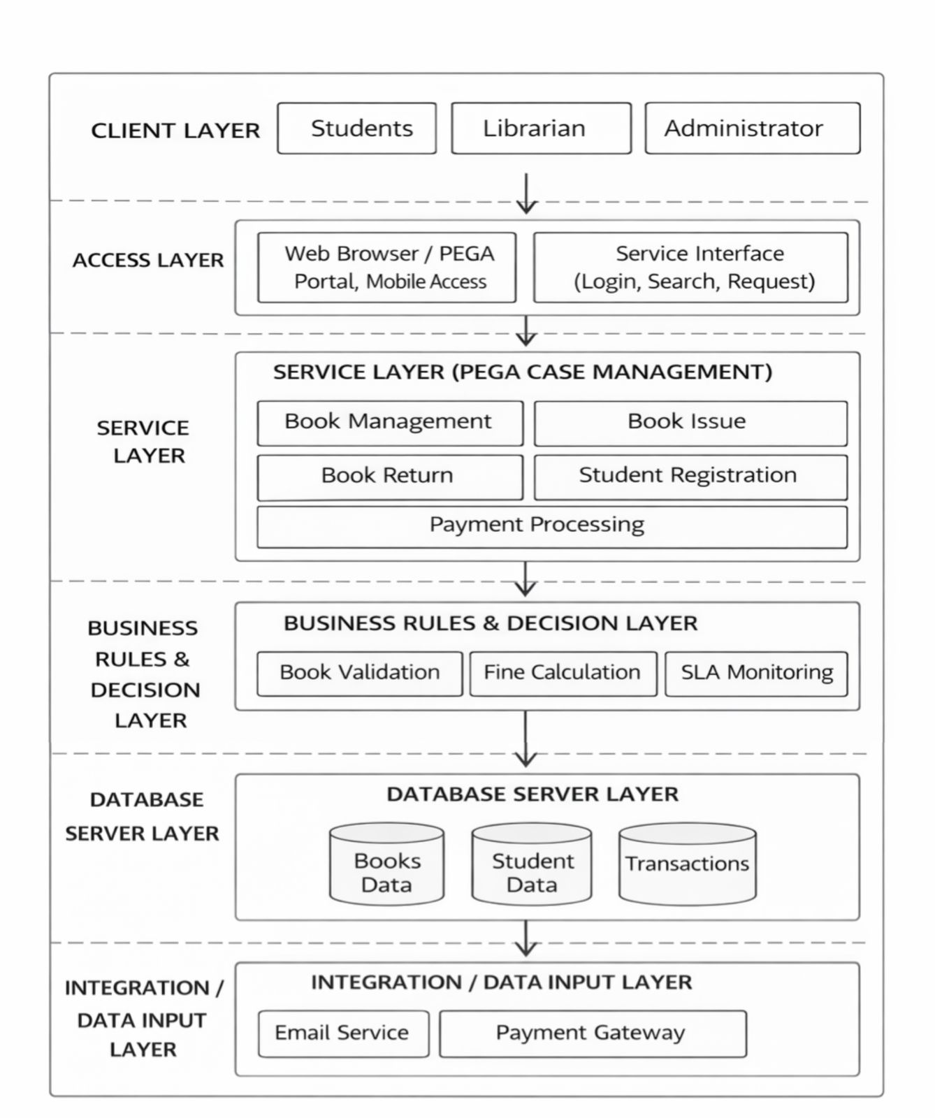
Architecture

Slide 4
METHODOLOGY
Methodology – Development Approach
Low-Code Development Method
Build applications using visual tools instead of coding
Agile Methodology
Development in small phases (iterations)
Continuous improvement and testing
Case Management Approach
Each request handled as a case
Example: Book Request → Approval → Issue → Return
Rule-Based Development
Business rules define system behavior
Easy to update without changing code
Continuous Testing
Testing at every stage of development
User-Centric Design
Focus on easy and simple user experience

Slide 5
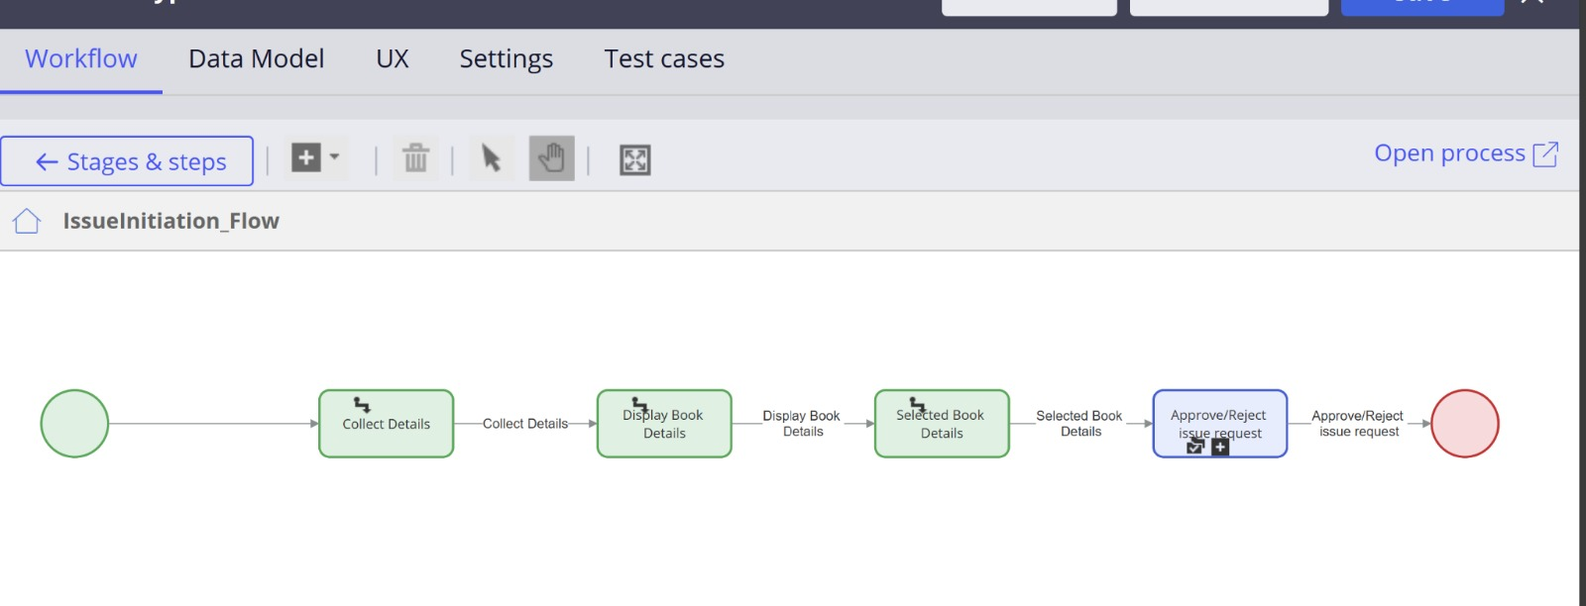
Partial implementation of a project book issue

Slide 6
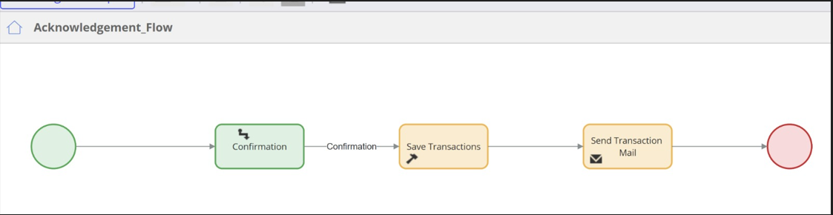
Book Acknowledgement

Slide 7
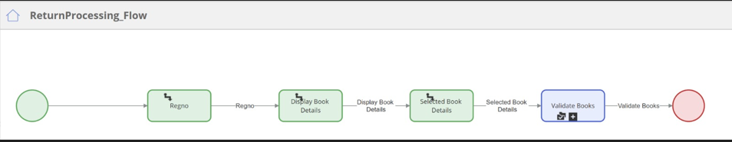
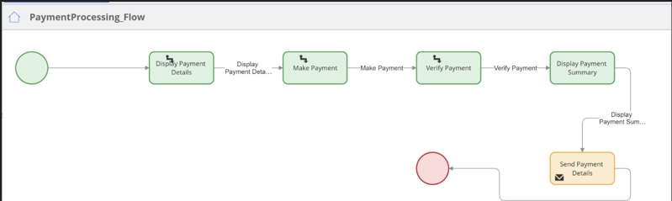
Book Return

Slide 8
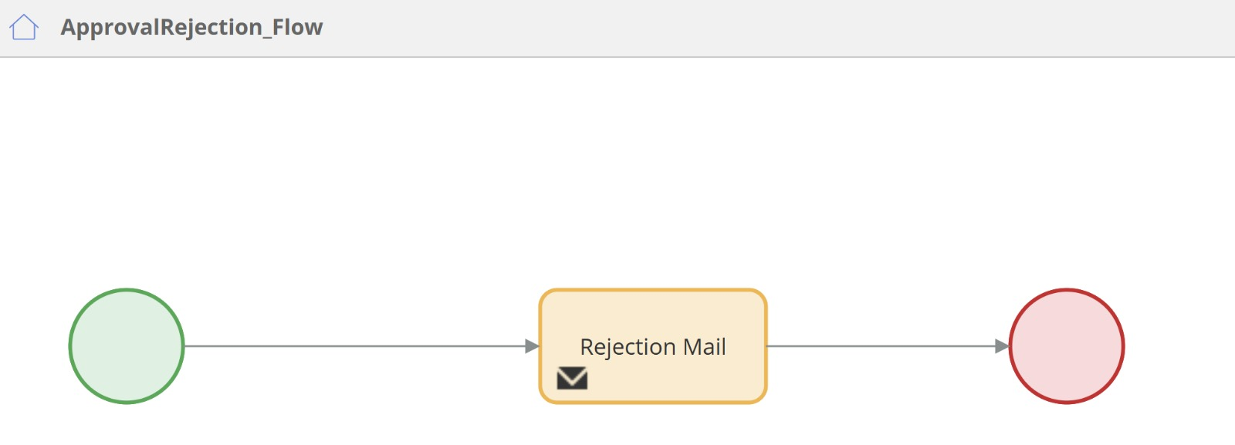
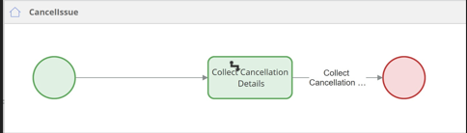
Book approval & Cancel

Slide 9
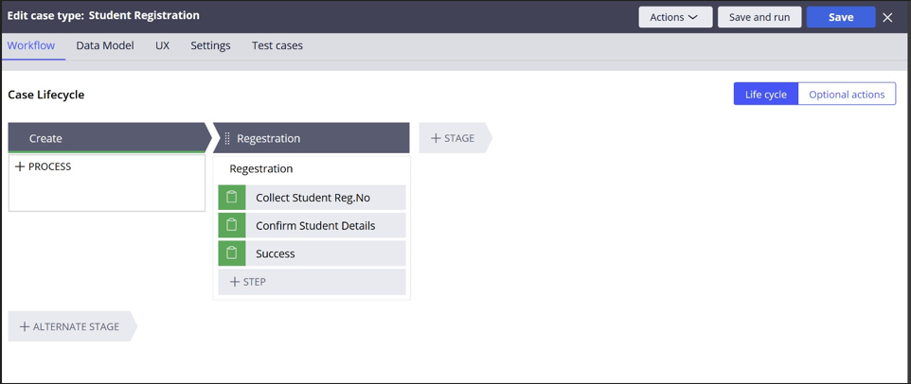
Student registration CASE TYPE

Slide 10
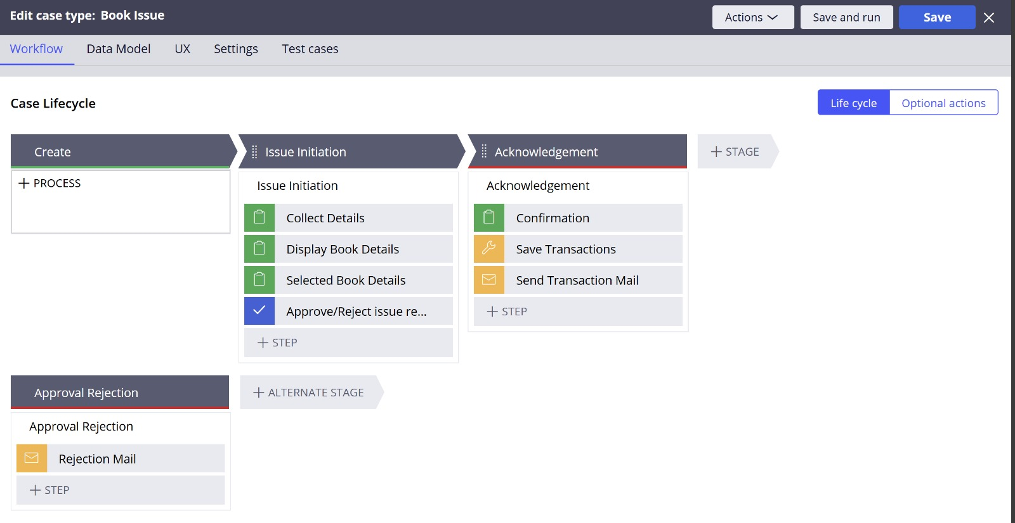
BOOK ISSUE CASE TYPE

Slide 11
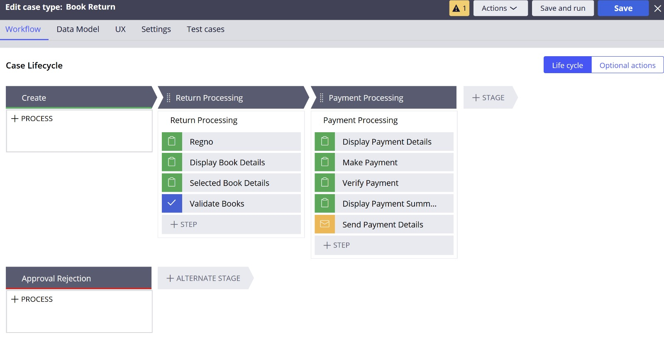
BOOK RETURN CASE TYPE

Slide 12
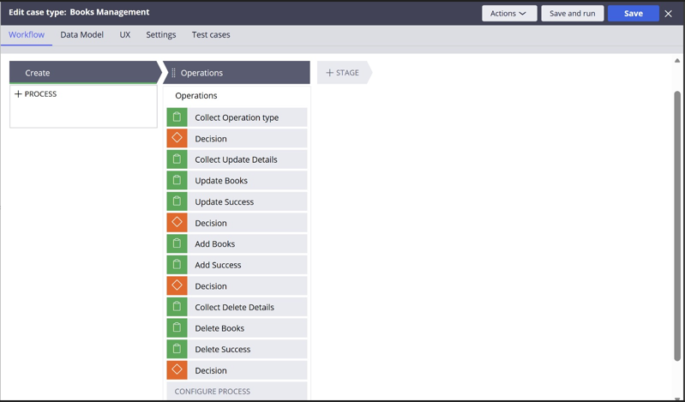
BOOKS MANAGEMENT CASE TYPE

Slide 13
ADVANTAGES
Low-code development
Faster application development
Automates library processes
Reduces manual work
Easy to manage using rules
User-friendly system
Real-time book tracking
Improves efficiency
Accurate record management
Scalable and flexible platform

Slide 14
Thank you

